Slide 1

High Impact Skills Development Program
in Artificial Intelligence, Data Science, and Blockchain
Module 9: Natural Language Processing
Lecture 1: Introduction to NLP
Instructor: Ahsan Jalal
Industry Trainer

Slide 2
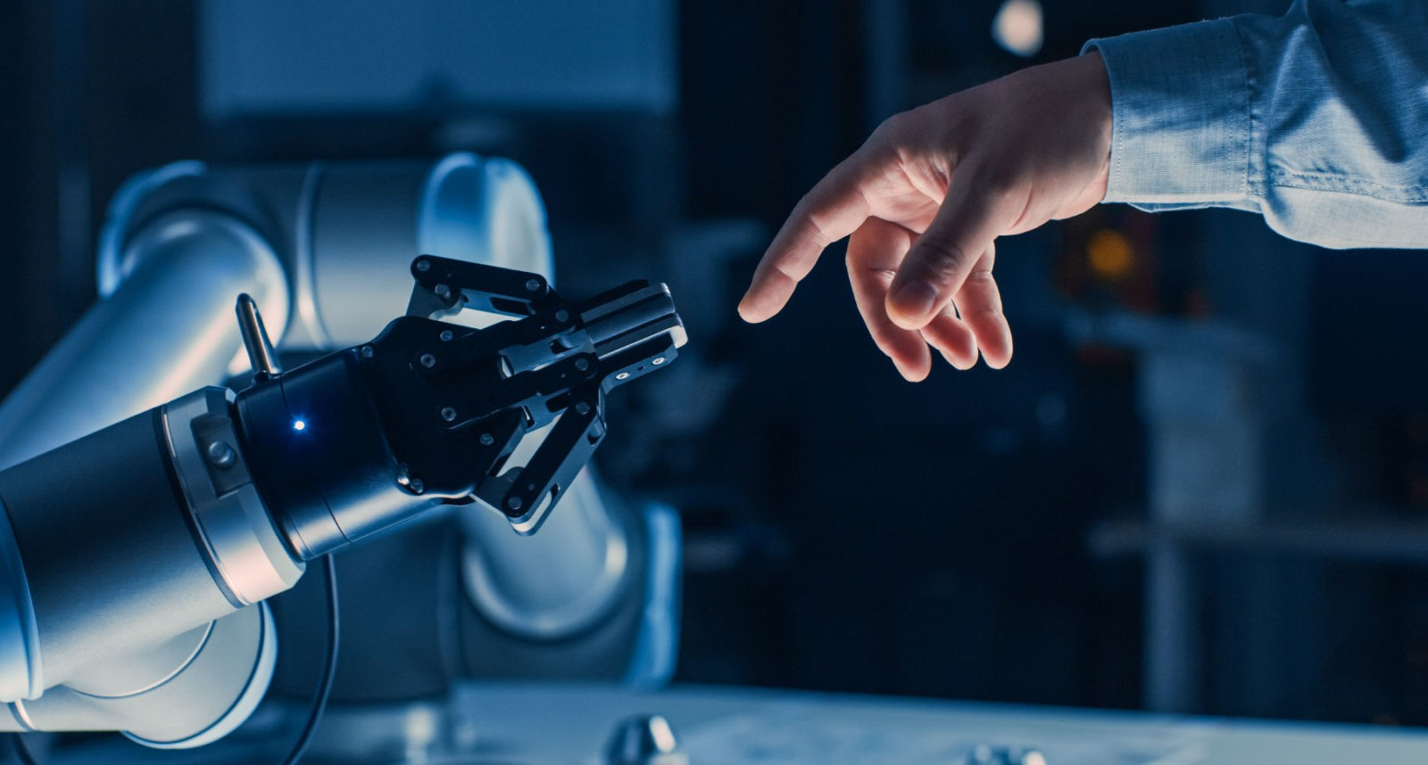
What is Natural Language Processing?
NLP is a branch of AI that,
Receives human language (spoken or written) as input.
Processes it to understand the meaning.
Acts upon it or responds.
NLP is a multidisciplinary field
It borrows concepts from AI, Computational Linguistics, and Cognitive Science among others.

Slide 3
What do you expect from this module?

Slide 4
Objectives of this module are three-fold
To establish the foundation of effective modern methods of deep learning applied to NLP.
To provide a broader understanding of natural languages and challenges in understanding and producing them.
To afford sound command of and ability to build systems for some of the major NLP problems.
Sentiment Analysis
Language Generation
Machine Translation

Slide 5
Related Areas
Artificial Intelligence
Formal Language (Automata) Theory
Machine Learning
Deep Learning
Linguistics
Psycholinguistics
Cognitive Science
Philosophy of Language

Slide 6

Why Natural Language Processing is important?
Language helps preserve and propagate knowledge.
Across time, across space
Bandwidth of humans to generate, process and propagate knowledge is limited.
If computers can understand natural language it can greatly help advance human civilisation.

Slide 7
How can we teach human language to computers?
To make computers understand human language, first we need to understand it ourselves.
She poured the water from the jug into the cup until it was full.
She poured the water from the jug into the cup until it was empty.
Human languages are complex.
Words only don’t convey the meaning.
They have a very small bandwidth.
Cannot convey large amount of information in short amount of time.
Natural languages make use of compression.
Requires knowledge of listener and context to fill the gaps.

Slide 8
Syntax Semantic Pragmatics
Syntax concerns the proper ordering of words and its affect on meaning.
The dog bit the boy.
The boy bit the dog.
Bit boy dog the the.
Colorless green ideas sleep furiously.
Semantics concerns the (literal) meaning of words, phrases, and sentences.
“plant” as a photosynthetic organism
“plant” as a manufacturing facility
“plant” as the act of sowing
Pragmatics concerns the overall communicative and social context and its effect on interpretation.
You have a green light
You have a green ambient lightening
Green light while driving a car
Go a head on a project
Possess a green light bulb

Slide 9
Ambiguity is Ubiquitous
Ambiguity is Ubiquitous
Speech Recognition
“recognize speech” vs. “wreck a nice beach”
“youth in Asia” vs. “euthanasia”
Syntactic Analysis
“I ate spaghetti with chopsticks” vs. “I ate spaghetti with meatballs.”
Semantic Analysis
“The dog is in the pen.” vs. “The ink is in the pen.”
“I put the plant in the window” vs. “Ford put the plant in Mexico”
Pragmatic Analysis
From “The Pink Panther Strikes Again”:
Clouseau: Does your dog bite? Hotel Clerk: No. Clouseau: [bowing down to pet the dog] Nice doggie. [Dog barks and bites Clouseau in the hand] Clouseau: I thought you said your dog did not bite! Hotel Clerk: That is not my dog.

Slide 10
Pipeline of NLP consists of three main components
Text Processing
Take raw input text, clean it, normalize it, and convert it into a form that is suitable for feature extraction.
Feature Extraction (word/document representation)
Extract and/or produce feature representations that are appropriate for the type of NLP task at hand and the type of model to be used.
Modelling
Design a model, fit its parameters to training data, use an optimization procedure, and then evaluate it to make predictions about unseen data.
There could be additional steps depending upon application

Slide 11
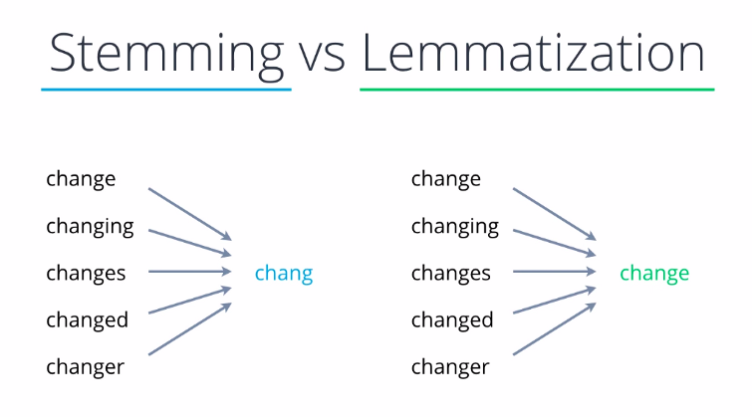
Pre-processing operations depend on the use case
Cleaning: Remove irrelevant items like HTML tags, symbols and non-alphabetic characters.
Normalisation: Convert all words to lowercase and removing punctuation and extra spaces.
Tokenisation: Split the text into words, also known as tokens.
Stop Words Removal: Remove the most common words (a, an, the, etc.).
Parts of Speech Tagging: Identify the parts of speech for the remaining words.
Named Entity Recognition: Recognize the named entities in the data.
Stemming and Lemmatisation: Convert words into their canonical / dictionary forms, using stemming and/or lemmatization.

Slide 12
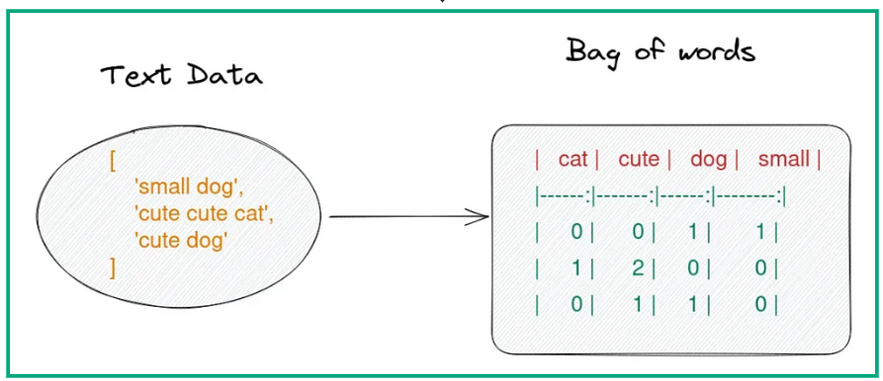
Feature Extraction means representing words as vectors of numbers
Text is represented by ASCII or Unicode which maps each character to a number.
Individual characters don’t carry much information/meaning.
Representing words as a sequence of ASCII/Unicode numbers does not capture the meaning of a word and its relationship with other words.
Suitable representation of text data depends on the task.
For document-level tasks like sentiment analysis, BOW or doc2vec may be used.
For word-level tasks like language generation or machine translation word2vec or GloVe may be used.
L | I | S | T | E | N
76 | 73 | 83 | 84 | 69 | 78
L | I | S | T | E | N
76 | 73 | 83 | 84 | 69 | 78
S | I | L | E | N | T
83 | 73 | 76 | 69 | 78 | 84
Notes:
Bag of words losses the information of word ordering , so cannot extract word relationship like power, France and paris
In word2 vec two algorithms works CBOW and skip gram
Cbow use surrounding words to predict the current word, the cat sat to predict on
In skip gram we use the current word to predict the surrounding words

Slide 13
Finally an NLP model is trained on the data and evaluated
Common examples of models are seq2seq models and Transformers.
Once again, picking the right model depends upon the task.

Slide 14
Every word in natural languages has a Denotation and a Connotation
Denotation
Connotation
Home: A place to live in
Childish: Like a child
Plant: A manufacturing facility, Photosynthetic organisms, An action of putting into place
Home: Security, Family, Shelter
Childish: Innocent, Stupid, Immature
Plant: Colonise, Conceal
Mostly Used in Formal Communication
Mostly Used in Poetry and Literature
Notes:
Denotaion: dictionary meaning cannotation: additional figurative meaning for example red rose is a flower or red rose is a symbol of love in poetry

Slide 15
How do computers understand the meaning of a word?
By using WordNet: A thesaurus containing lists of synonyms and hypernyms.
Synonyms
Hypernyms
Good: noun, Goodness
noun, Commodity
adj, Good
adj, Honourable
adj, Beneficial
adv, Well
adv, Thoroughly
Panda: Animal
Carnivores
Mammal
Physical Entity
Living Thing
Placental
Vertebrate
https://wordnet.princeton.edu/

Slide 16
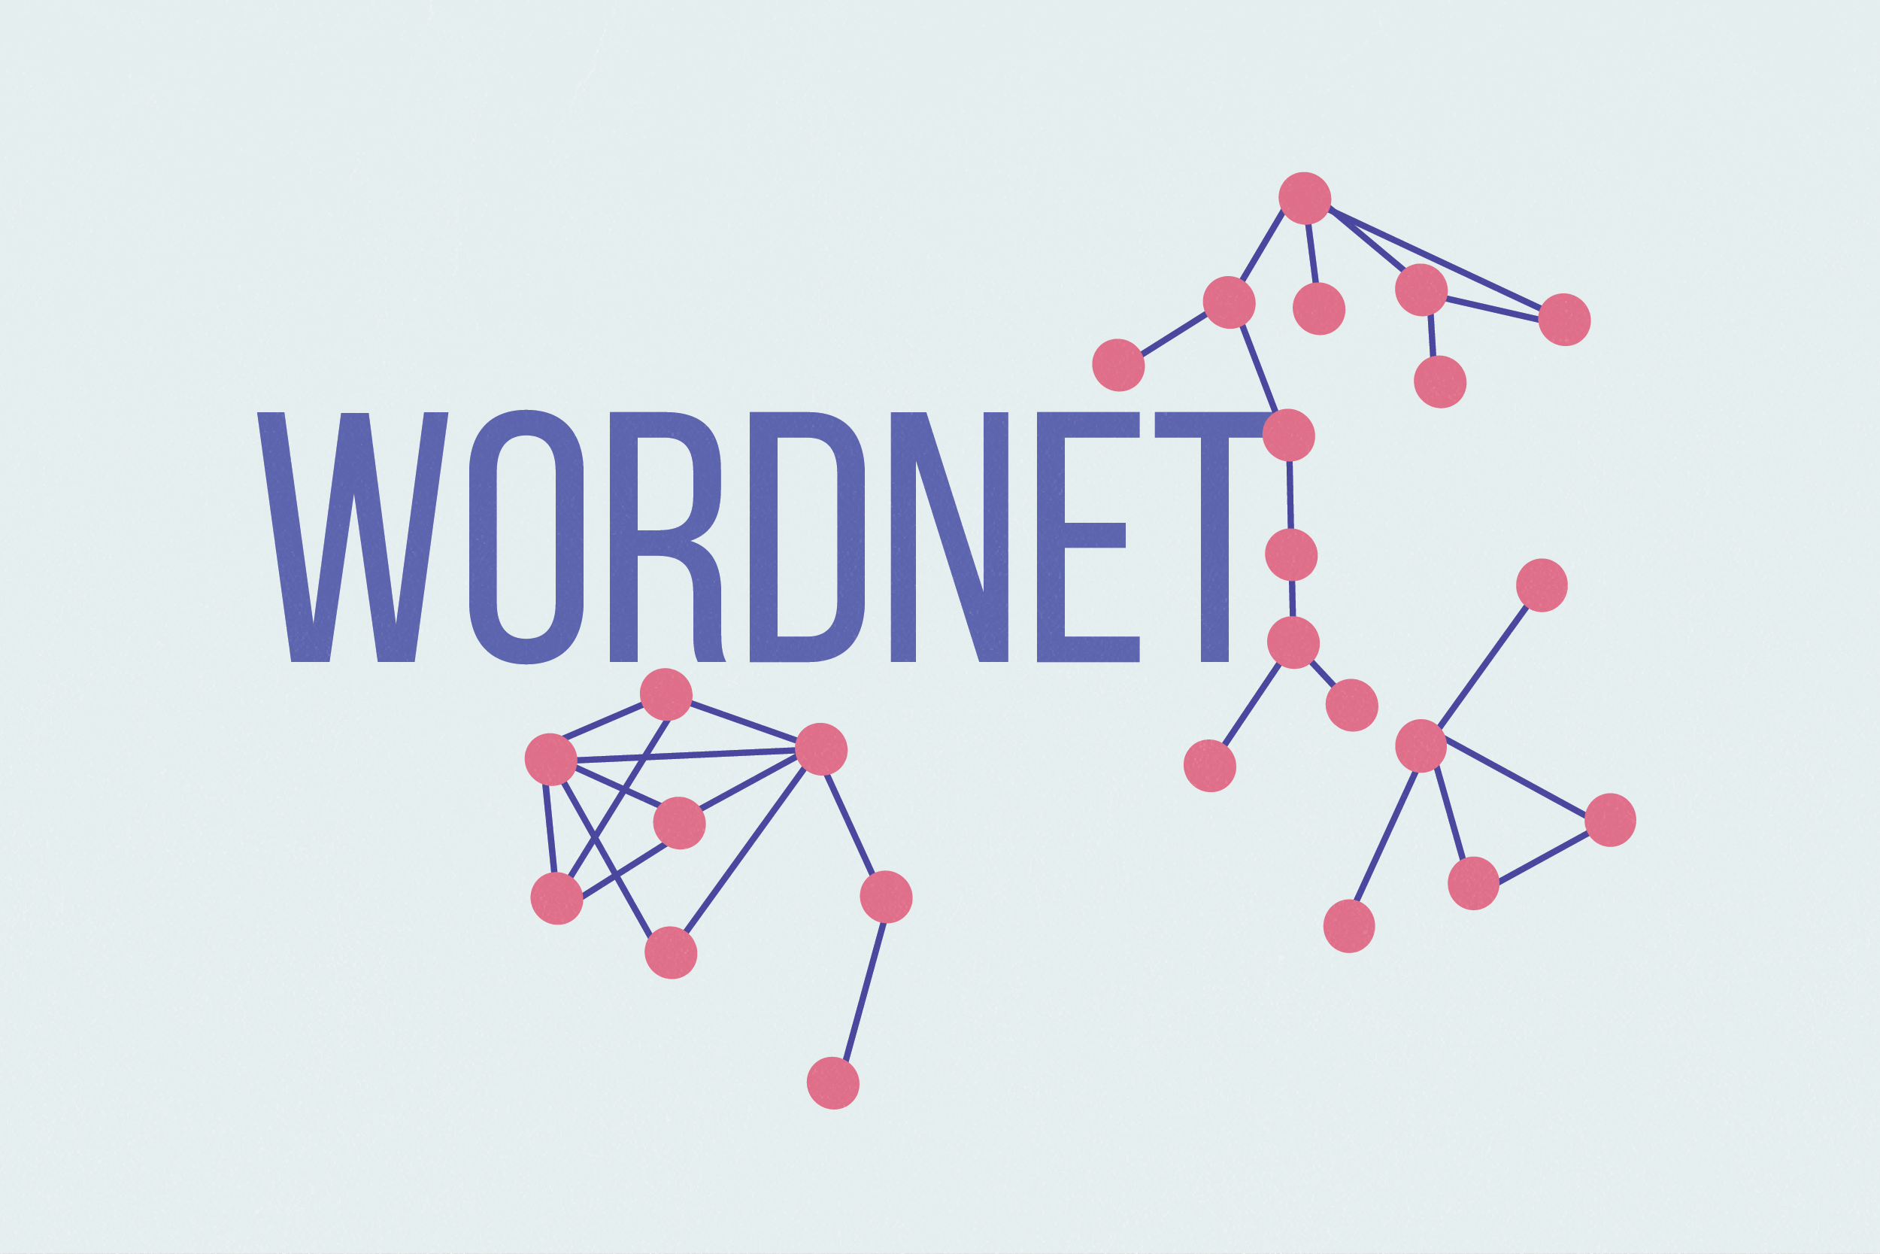
WordNet is like a Swiss Army knife
Missing new meaning of words.
Wicked, Badass, Wizard, Ninja
Very difficult to keep up-to-date
Subjective.
Therefore, incomplete
Requires manual labour to curate.
What’s the purpose of AI, then?
Can’t compute accurate word similarity.
No partial resemblance
Has only fixed synonym set

Slide 17
Computers cannot understand words
Localist Representation consider words as discrete symbols.
It was practiced in traditional NLP (up until 2012).
Example: One-Hot Encoding
What are the problems with Localist Representation?
Very large vectors for each word (due to deviational morphology)
Each vector is orthogonal to all others (what does it mean?)
Resultant matrix is sparse.
Leopard | 1 | 0 | 0 | 0 | 0 | 0
Sofa | 0 | 1 | 0 | 0 | 0 | 0
Spider | 0 | 0 | 1 | 0 | 0 | 0
Panther | 0 | 0 | 0 | 1 | 0 | 0
Chair | 0 | 0 | 0 | 0 | 1 | 0
Give | 0 | 0 | 0 | 0 | 0 | 1
Leopard | 1 | 0 | 0 | 0 | 0 | 0 | 0 | 0 | 0
Sofa | 0 | 1 | 0 | 0 | 0 | 0 | 0 | 0 | 0
Spider | 0 | 0 | 1 | 0 | 0 | 0 | 0 | 0 | 0
Panther | 0 | 0 | 0 | 1 | 0 | 0 | 0 | 0 | 0
Chair | 0 | 0 | 0 | 0 | 1 | 0 | 0 | 0 | 0
Give | 0 | 0 | 0 | 0 | 0 | 1 | 0 | 0 | 0
Gave | 0 | 0 | 0 | 0 | 0 | 0 | 1 | 0 | 0
Gives | 0 | 0 | 0 | 0 | 0 | 0 | 0 | 1 | 0
Given | 0 | 0 | 0 | 0 | 0 | 0 | 0 | 0 | 1

Slide 18
How to find similarity between two words?
Maybe rely on WordNet’s list of synonyms to get similarity?
Has been tried already. Failed miserably because of incompleteness.
Pre-calculate similarity of each word with every other word and put it in a table?
Google did that. The table size grows exponentially.
Learn to encode similarity in the word representation.
Smart and efficient

Slide 19
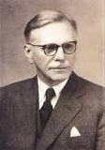
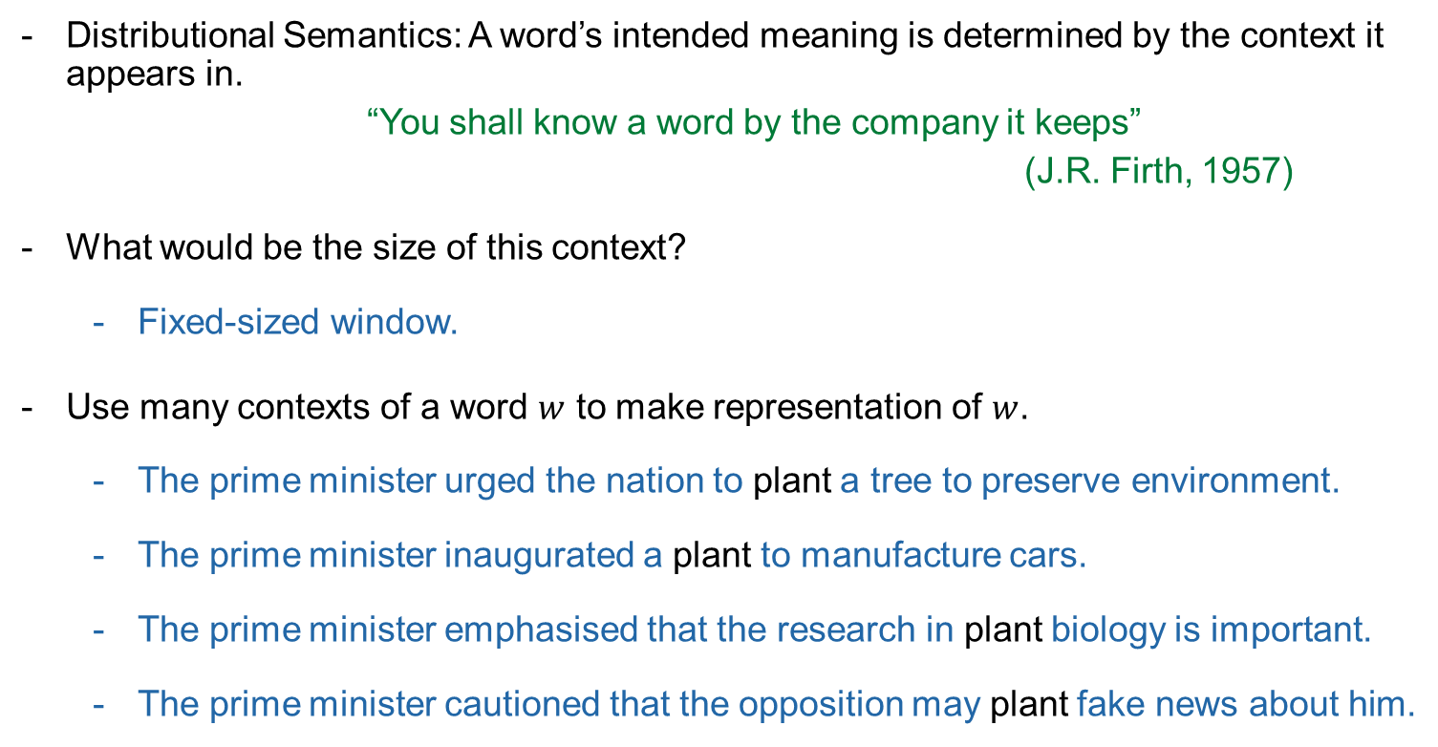
Represent words by the context in which they appear
John R. Firth
(1890 - 1960)

Slide 20
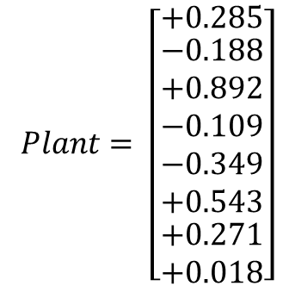
Represent each word by a dense vector of real numbers
Makes a smaller and dense vector for each word, such that it’s similar to the vectors of words that co-occur in similar context.
The example word vector for the word ‘plant’ is an 8-dimentional vector.
In practice, the dimensions of this vector can range from hundreds to thousands.
These word vectors are also called word embeddings or word representations.

Slide 21
Review of today’s lecture
In this lecture we learnt,
What is NLP and why it’s important.
The pipeline of an NLP project.
Some techniques for raw text data preprocessing
Motivation behind learning word-vectors.
In the next lecture, we will learn,
Statistical Language Modelling

